Slide 1

Stone Inscription Recognition and Identification System
SRM INSTITUTE OF SCIENCE AND TECHNOLOGY
SCHOOL OF COMPUTING
DEPARTMENT OF COMPUTING TECHNOLOGIES
18CSP107L - MINOR PROJECT
UNDER THE GUIDANCE OF :-
DR. C. SINDHU
ASSISTANT PROFESSOR
DEPARTMENT OF
COMPUTING TECHNOLOGIES
PRESENTED BY :-
KALLURI SHANMUKHA SAI [RA2011003010841]
AKULA TRIYAN SUBRAMANYAM [RA2011003010870]

Slide 2
ABSTRACT
Ancient stone inscriptions serve as invaluable cultural and historical artifacts, offering insights into past civilizations and their written languages. The current field of Character recognition focusses more on Recurrent neural networks and Convolutional neural networks. This research presents an innovative approach to address these challenges by employing the Histogram of Oriented Gradients feature extraction technique in character recognition. The expectation of our work is to develop a robust and accurate method for automatically recognizing and transcribing characters from weathered and diverse ancient stone inscriptions, facilitating the preservation and understanding of cultural heritage.

Slide 3
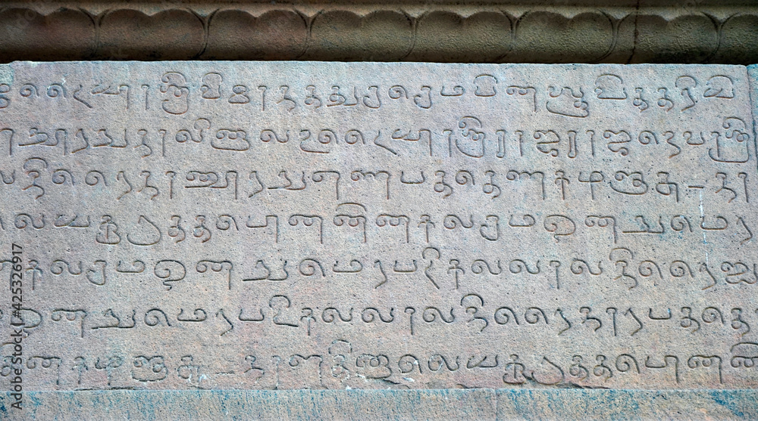
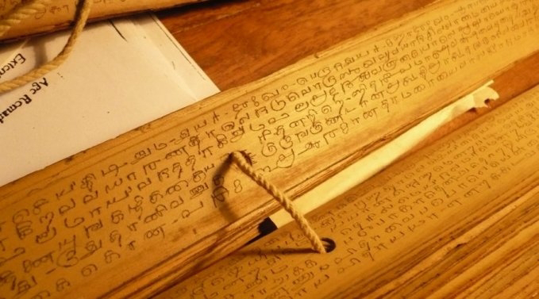
INTRODUCTION
Epigraphy
Palm Leaf Manuscripts
Paleography
Tamil Stone Inscriptions at Brihadeeswarar temple in Thanjavur , dated 1010AD
Palm Leaf Manuscripts written in Tamil, dated 5th century BC

Slide 4
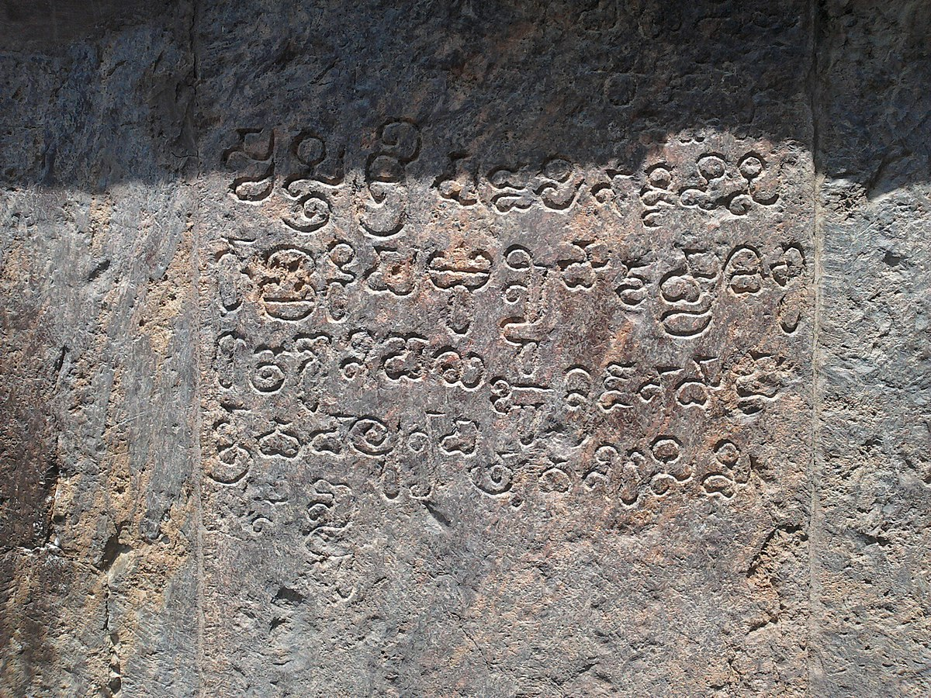
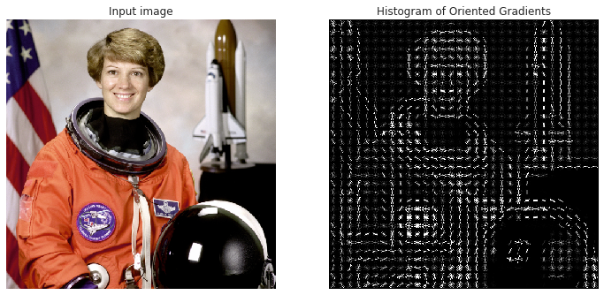
Ancient Stone Inscriptions
HOG (Histogram of Oriented Gradients)
Feature Extraction
Linguistic Analysis
Cultural Heritage
Telugu Stone Inscriptions at Srimukhalingeswara Temple in Andhra Pradesh, dated 10th century AD

Slide 5
SCOPE
Data Collection and Compilation:Curate a dataset that includes variations in lighting, angles, and degradation levels to simulate real-world scenarios.
Feature Extraction: Explore techniques like edge detection, contour analysis, and texture analysis.
Future Enhancements: Outline potential avenues for improvement, such as integrating Natural Language Processing (NLP) to improve context understanding, or extending the system to handle damaged or incomplete inscriptions

Slide 6
TASKS
Data Collection and Preparation
Preprocessing and Image Enhancement
Model Selection and Development
Model Training
Model Evaluation and Fine-Tuning
Script and Language Diversity

Slide 7
CHALLENGES
Limited and Degraded Data: Ancient inscriptions often suffer from degradation due to weathering, erosion, and time, leading to variations in character shapes and quality.
Character Variability: Characters within a script can vary in terms of style, stroke width, and structure, making accurate segmentation and recognition difficult.
Limited Context: Many inscriptions lack proper context, making it challenging to disambiguate characters that might look similar but have different meanings.

Slide 8
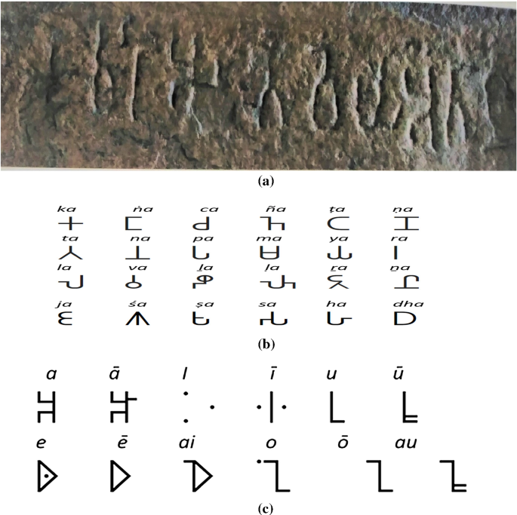
EXISTING SYSTEM
The systems typically employ preprocessing steps like image enhancement and noise reduction to improve the quality of input images. Subsequently, they utilize machine learning algorithms, such as convolutional neural networks (CNNs) or recurrent neural networks (RNNs), trained on annotated datasets of ancient scripts, to recognize and classify characters.
Existing system;
Georgian Language

Slide 9
PROBLEM STATEMENT
To recognize the characters in the stone inscriptions by overcoming the erosion and degradations of inscriptions over time and successfully implementing the HOG approach to efficiently decipher text thereby promoting cultural heritage.

Slide 10
OBJECTIVES
Implement HOG-based Feature Extraction
Build a Labeled Dataset
Develop a Character Recognition Model
Evaluate Performance

Slide 11
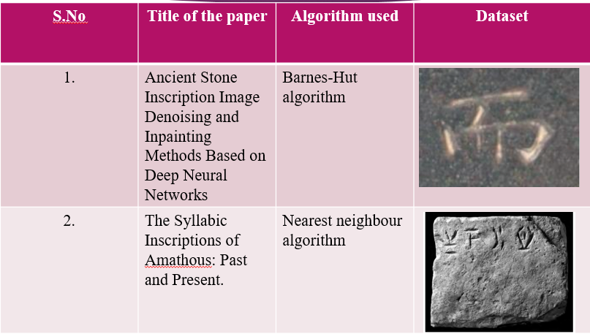
DATASETS OF SIMILAR PAPERS

Slide 12
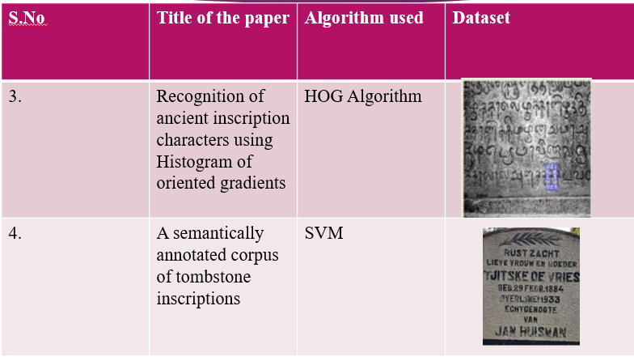

Slide 13
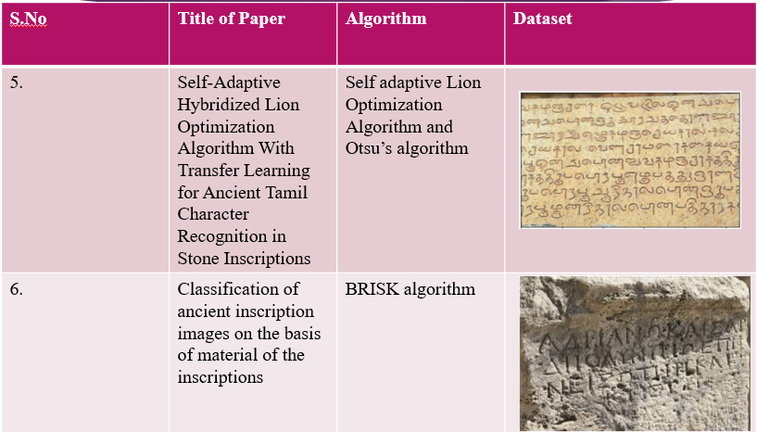

Slide 14
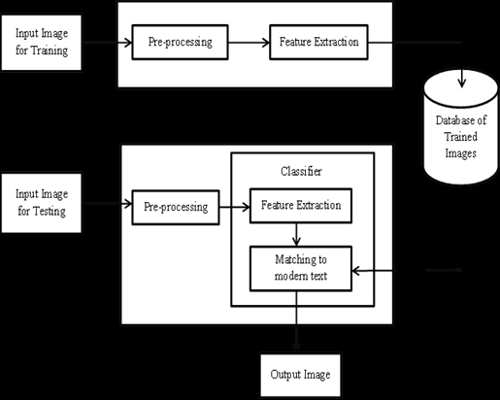
BLOCK DIAGRAM OF THE PROPOSED MODEL

Slide 15
MODULES DESCRIPTION
Pre-processing step 1: Gray scale Conversion
The first step is to convert stone inscription images from RGB color format to gray scale color images in order to get single intensity information.
Gray scale Images are composed exclusively of shades of gray, varying from black at the weakest intensity to white at the strongest.
RGB values are converted to gray scale values by forming a weighted sum of the R, G, and B components as follows.
Intensity = 0.2989 * R + 0.5870 * G + 0.1140 * B

Slide 16
Filtration
Noise can be removed from the image using the median filter of size 5X5. The median filter replaces the pixel value with the median of neighbouring pixel values.
The median is calculated by first sorting all the pixel values from the surrounding neighbourhood into numerical order and then replacing the pixel being considered with the middle pixel value.
Normalization
In size normalization, the images of different sizes are normalized to constant dimensions 40 X 40 by keeping the aspect ratio of the images.
The height and width ratio of original pattern is retained using a bilinear interpolation algorithm.

Slide 17
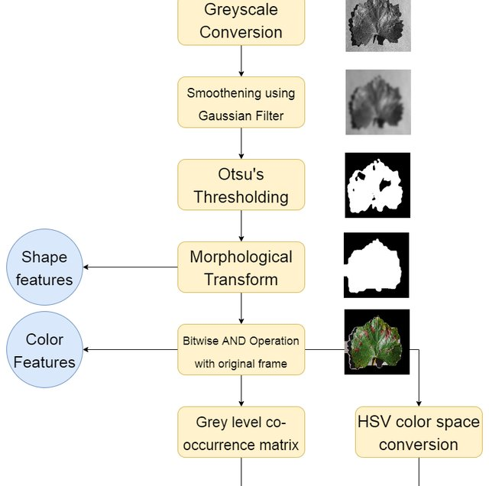

Slide 18
SMOOTHING USING GAUSSIAN FILTER
A Gaussian filter is a type of linear filter that is used to smooth images. It works by convolving the image with a Gaussian kernel, which is a bell-shaped function. The Gaussian kernel has a standard deviation parameter, which controls the amount of smoothing that is applied to the image.
Gaussian filters are effective at smoothing images because they suppress high-frequency noise while preserving low-frequency components of the image. This is because the Gaussian kernel is weighted towards the centre, so pixels that are close to each other have a greater influence on the filtered image than pixels that are further away.

Slide 19
OTSU BINARY THRESHOLD
Otsu's binary threshold is a method for thresholding an image to convert it from grayscale to binary. It is a global thresholding method, which means that it uses a single threshold value to convert the entire image to binary.
Otsu's binary threshold works by finding the threshold value that maximizes the variance between the foreground and background pixels. This is done by calculating the between- class variance for each possible threshold value and then selecting the threshold value thatproduces the highest between-class variance.
Otsu's binary threshold is a simple and effective method for thresholding images. It is particularly useful for images with high contrast between the foreground and background pixels.

Slide 20
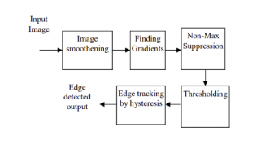
Canny Edge Detection Algorithm
The Canny Edge Detection algorithm is a widely used edge detection algorithm in today’s image processing applications.
Canny edge detection algorithm produces smoother, thinner, and cleaner images than Sobel and Prewitt filters.

Slide 21
WATERSHED ALGORITHM
The watershed algorithm is a segmentation algorithm that is used to divide an image into different regions. It is based on the analogy of water flowing over a surface. The algorithm works by finding the catchment basins of the surface, which are the regions where water would collect. The catchment basins are then separated by watersheds, which are the ridges that divide the catchment basins.
The watershed algorithm is typically applied to grayscale images. The first step is to convert the grayscale image to a topographic surface. This can be done by using a gradient operator to calculate the slope of the surface at each pixel. The second step is to find the local minima of the surface. These are the points where the surface is lowest and where water would start to collect. The local minima are then marked as markers.

Slide 22
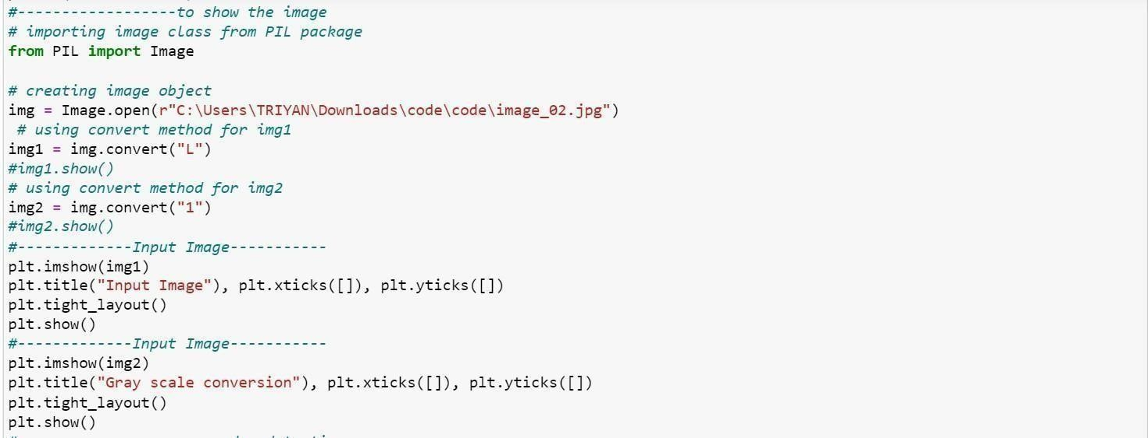
CODE SNAPSHOTS
Gray Scale Conversion code

Slide 23
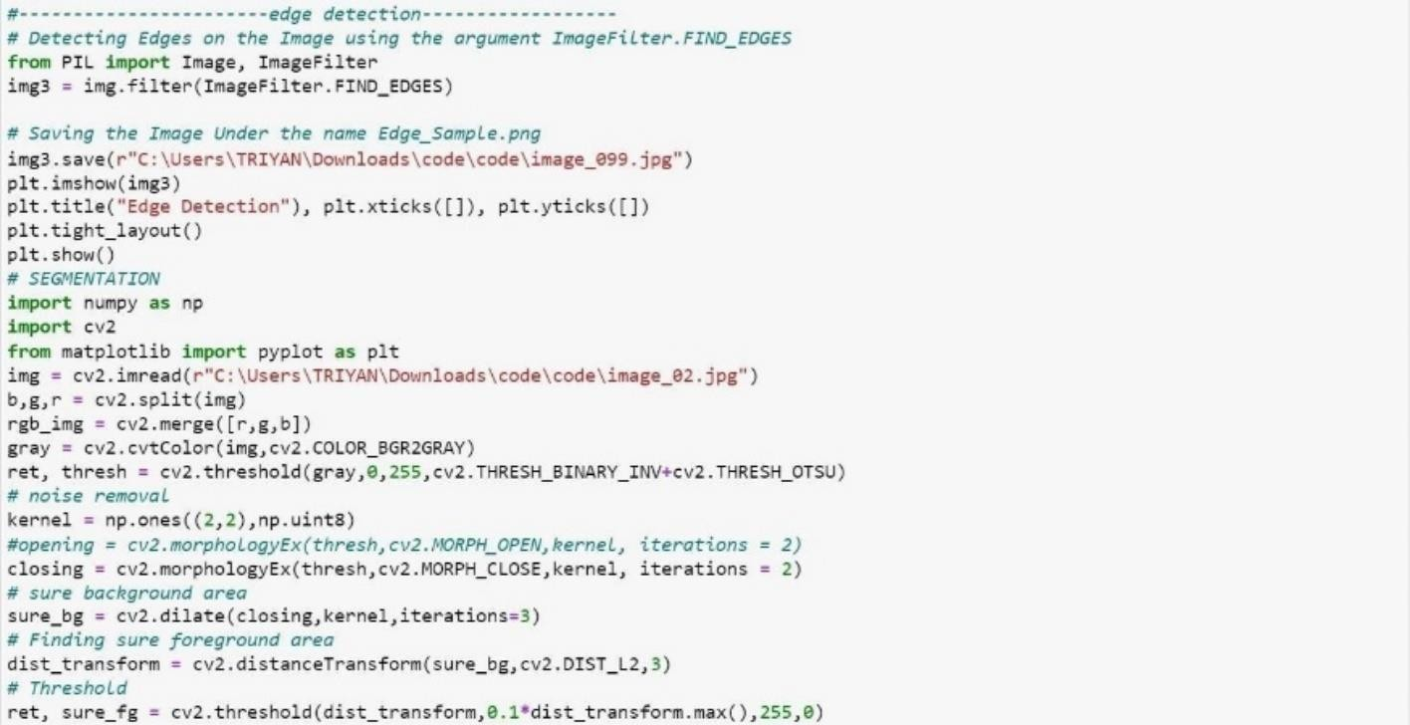
Edge detection code

Slide 24
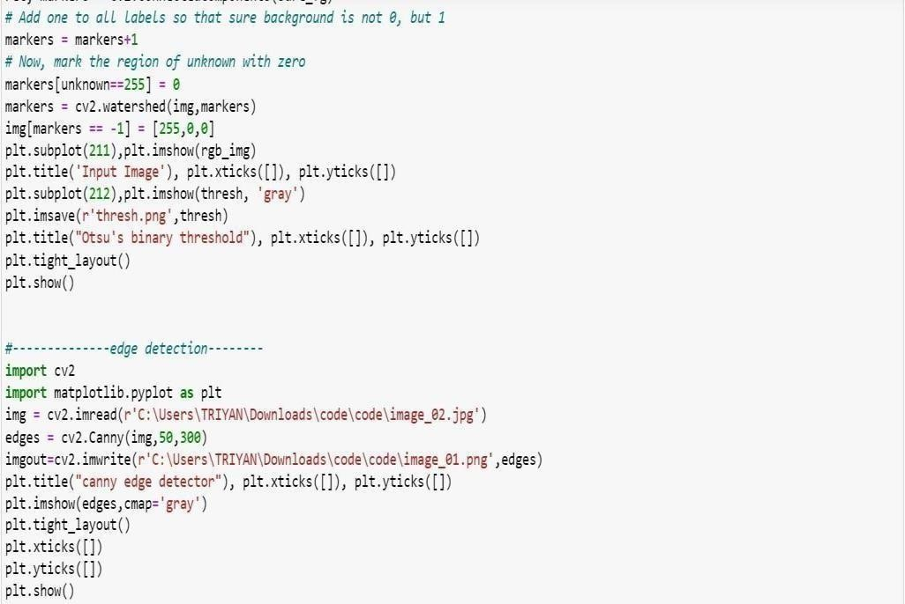
Otsu’s binary threshold code

Slide 25
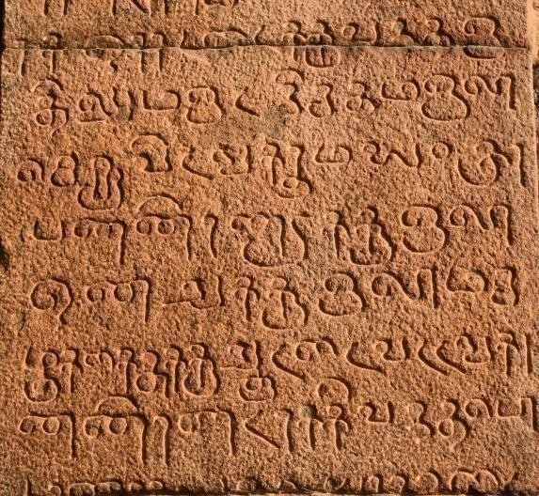
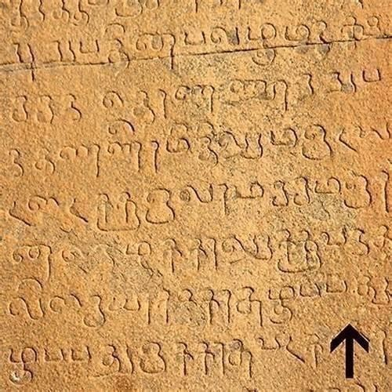
Few Datasets
Inscriptions from Brihadeeswarar temple and Airavatesvara temple respectively

Slide 26
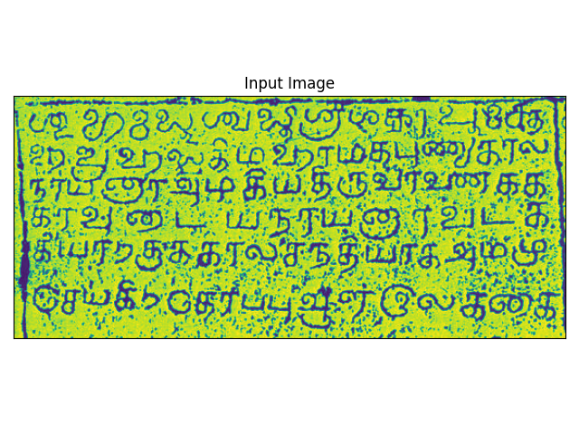
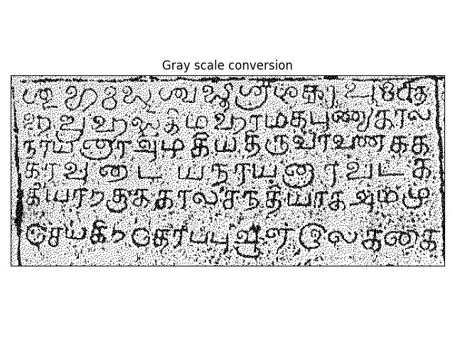
Intermediate Results and Discussion
T
The input image and the grayscale conversion of the image

Slide 27
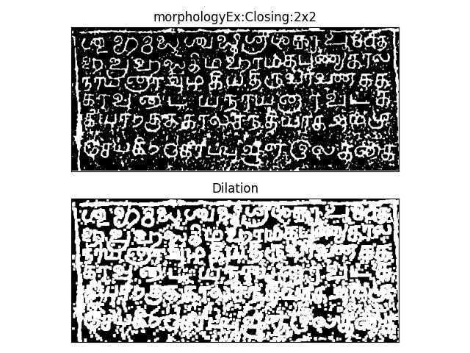
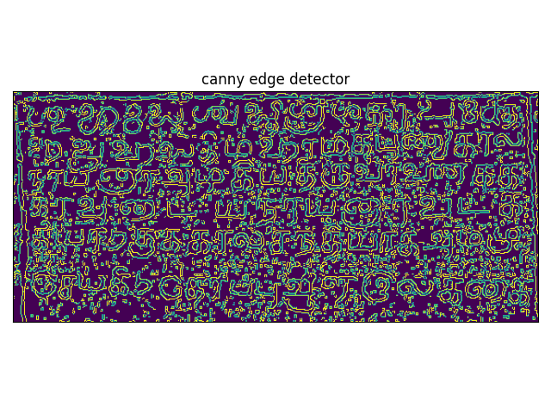
Edge Detection based on Canny Edge detection Algorithm.

Slide 28
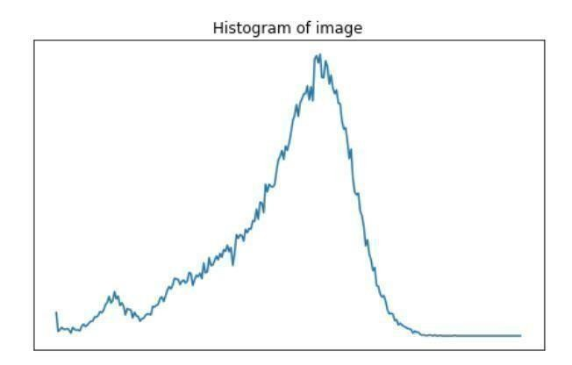
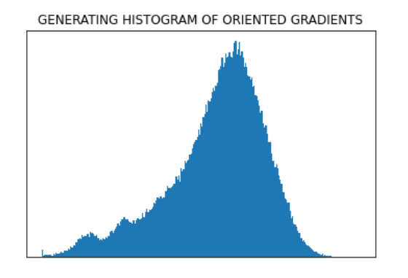

Slide 29
References
[1] Siromoney et al., “Computer Recognition of Printed Tamil Character”, Pattern Recognition, 1978, pg no: 243-247.
[2] Chinnuswamy, P., and S.G. Krishnamoorthy, “Recognition of Hand printed Tamil Characters”, 1980, Pattern Recognition, 12: 141-152.
[3] Suresh et al., “Recognition of Hand printed Tamil Characters Using Classification Approach”,1999, ICAPRDT’ 99, pp: 63-84.
[4] Hewavitharana, S, and H.C. Fernando, “A Two-Stage Classification Approach to Tamil Handwriting Recognition”, pp: 118-124, Tamil Internet 2002, California, USA.
[5] N. Shanthi and K. Duraiswamy, “Performance Comparison of Different Image Sizes for Recognizing Unconstrained Handwritten Tamil Characters using SVM”, Journal of Computer Science,Vol 3, Issue 9, Pages 760-764, 2007.

Slide 30
[6] Shivsubramani K, Loganathan R, Srinivasan CJ, Ajay V, Soman KP, “Multiclass Hierarchical SVM for Recognition of Printed Tamil Characters”, In:Proc.of IJCAI, 2007.
[7] Szedmak ,Sandor Szedmak, John Shawe- Taylor, “Learning Hierarchies at Two-class Complexity”,Kernel Methods andStructured domains,NIPS 2005.
[8] K.H.Aparna, Sumanth Jaganathan, P.Krishnan, V.S.Chakravarthy, "Document Image Analysis: with specific Application to Tamil Newsprint", International Conference on Universal Knowledge and Language (ICUKL), Goa, India, Nov. 2002.
[9] N. Joshi, G. Sita, A. G. Ramakrishnan, and S. Madhvanath,” Comparison of Elastic Matching Algorithms for Online Tamil Handwritten Character Recognition” Proceedings of the 9th International Workshop on Frontiers in Handwriting Recognition, 2004.
[10] Seethalakshmi R., Sreeranjani T.R., Balachandar T., Abnikant Singh,Markandey Singh, Ritwaj Ratan, Sarvesh Kumar, "Optical Character Recognition for printed Tamil text using Unicode", Journal of Zhejiang University SCIENCE, Vol. 6A No. 11, 2005.

